Slide 1

Welcome to Section
Week one
You’ve just taken your first step into the world of coding , and that’s something to be proud of.I know it can feel a bit scary at first, but don’t worry , you’re not doing this alone. We’re all here to learn together, and I’ll be with you every step of the way.

Slide 2
Introductions

Slide 3

A little about Me
My name is _____. I’ll be your Section Leader for Code in Place, and everyone here will be your section-mates!
I am majoring/working in _____.
In my free time I like to _____.
I enjoy _____.

Slide 4
What About You All?
Your name
Where you’re tuning in from
What brings you to Code in Place
And a fun fact about you
If you aren’t warmed up and comfortable with speaking just yet, that’s fine! You can share directly to everyone in the chat or you can message me and I can read aout your introduction for you!
And also, just so you know, if there’s anything I can do to make this space feel more inclusive or comfortable for you, please feel free to private message me any time.

Slide 5




BREAKING THE ICE
Share your names one more time Innovation
Icebreaker Question: What’s your dream project?
If no one wants to share first, the person who is geographically closest to Stanford shares first

Slide 6
Lecture Review

Slide 7

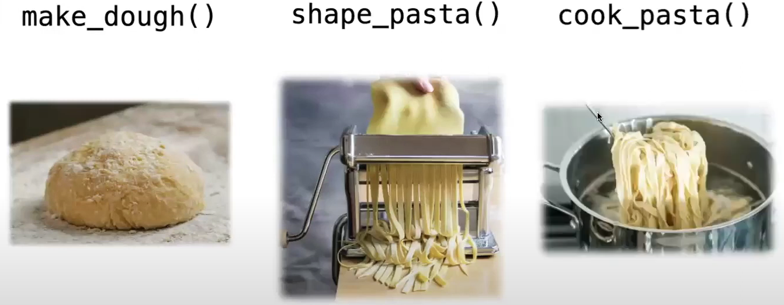
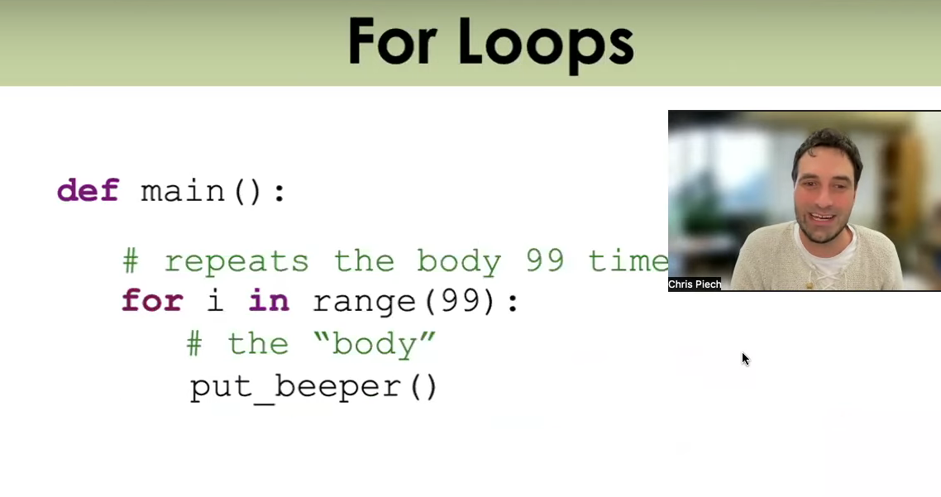
What We’ve Learned
Before we get into our sample problem for today, let’s review a bit. We’ve learned:
The basics about Karel, the magnificent and wonderful robot
Karel
Functions, a way of breaking down big problems into smaller chunks
Functions
Control Flow, loops and conditional statements which guide our programs
For loops
This is a LOT of content, especially if you are newer to CS!
Fact

Slide 8
Let’s review and refresh these concepts a bit!

Slide 9
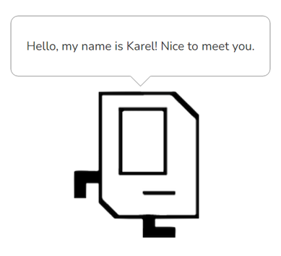
Karel Overview
1 image and description
Karel is a small, but mighty robot!!!
It has a few basic commands including: move(), turn_left(), pick_beeper(), and put_beeper()
On its own, Karel has limited functionality, but with the help of our code, we can make great things happen!

Slide 10
Functions Overview
One Column
When you think of functions, recall Chris and Mehran’s analogy to making pasta. Each function has a specific purpose which breaks down a larger problem into smaller chunks—just like steps in making pasta from scratch!
To make a function, you need to define it using the def keyword. Afterwords, write the code you want the function to run. Make sure the code is indented below the function name like so:
def function_name():
# Function code goes here!!!

Slide 11
Control Flow Overview
Lastly, let’s take a look at control flow! We have:
For-loop (definite loop):
Performs some block of code, a specific amount of times.
While-loop (indefinite loop):
Continuously perform a block of code until what’s being tested is evaluated to false.
If-statement:
Tests for truth. Performs a block of code only when evaluated to true.

Slide 12
For-Loop
Long text only
An example for-loop that you may see and use with Karel:
def turn_right():
for i in range(3):
turn_left()
This loop is also called a definite loop because we know where it ends, when i reaches 3. (Be careful to remember that i begins at 0 when we start our loop!!!)

Slide 13
While-Loop
Long text only
An example while-loop that you may see and use with Karel:
def move_to_wall():
while front_is_clear():
move()
This loop is also called an indefinite loop because it will run until the associated condition becomes false, which may be never! Who knows? You will, hopefully. Be careful so you don’t get stuck in an infinite loop while using this!

Slide 14
If-Statement
Long text only
An example if-statement that you may see and use with Karel:
def safe_move():
if front_is_clear():
move()
An if-statement runs code inside of it when the associated statement is evaluated to true. We will get into more complex statements later on in the course to add much more flexibility to our if-statements!

Slide 15
Any Questions?

Slide 16
Section Problem: Hospital Karel

Slide 17
Setting Context
One Column
Countries around the world are dispatching hospital-building robots to make sure anyone who gets sick can be treated. They have decided to enlist Karel robots. Your job is to program those robots.

Slide 18
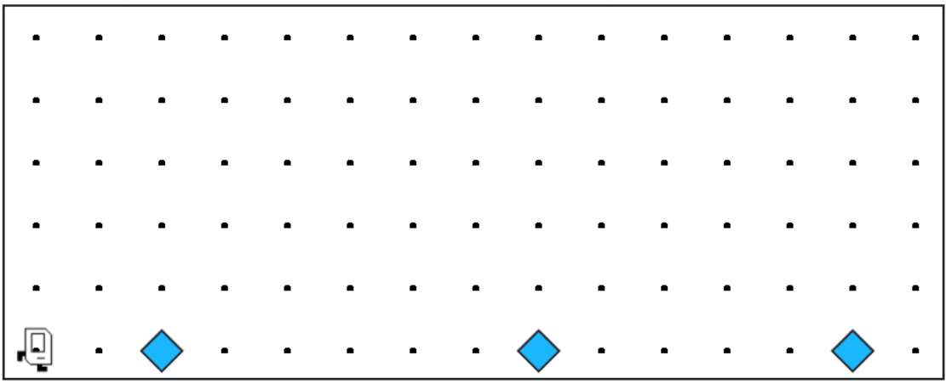
Setting Context
Each beeper in the figure represents a pile of supplies.

Slide 19
Setting Context
Karel’s job is to walk along the row and build a new hospital in the places marked by each beeper.
Build Hospital
Build Hospital
Build Hospital

Slide 20
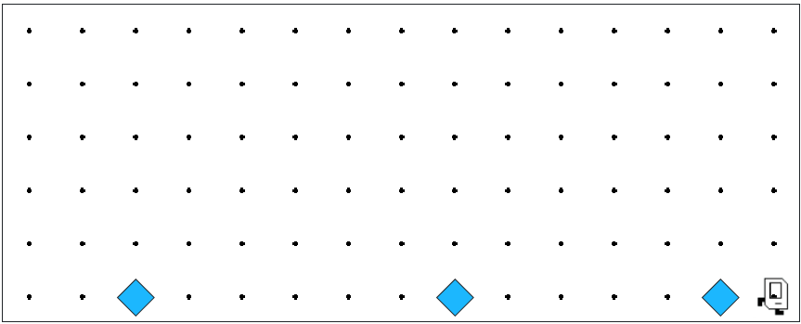

Setting Context
Karel’s job is to walk along the row and build a new hospital in the places marked by each beeper.

Slide 21

Setting Context
Hospitals look like this: a 3x2 rectangle of beepers!

Slide 22
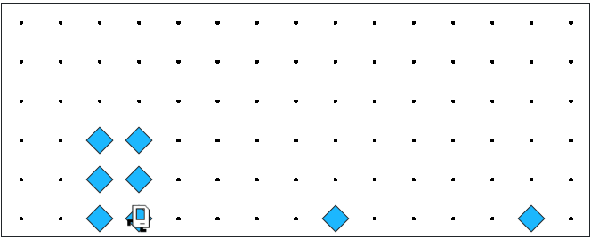
Setting Context
The new hospital should have their corner at the point at which the pile of supplies was left.

Slide 23
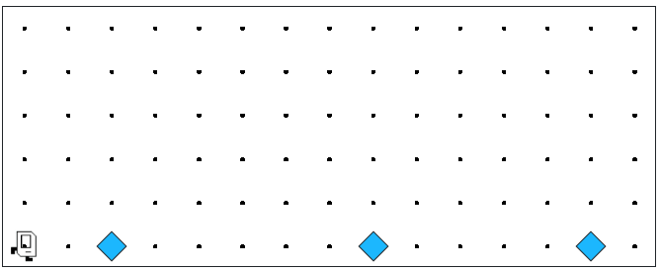
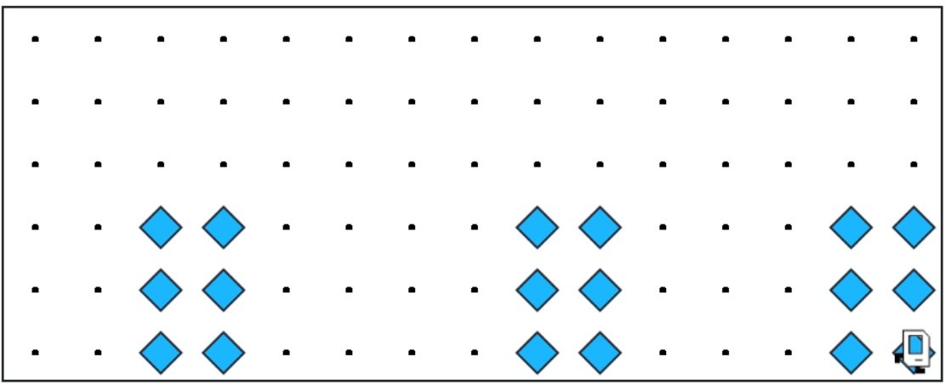
Setting Context
At the end of the run, Karel should be at the end of the row having created a set of hospitals. For the initial conditions shown, the result would look like this:

Slide 24

Notes to Keep in Mind
A left big image and 4 list items
1
Karel starts facing east at (1, 1) with an infinite number of beepers in its beeper bag.
2
The beepers indicating the positions at which hospitals should be built will be spaced so that there is room to build the hospitals without overlapping or hitting walls.
3
There will be no supplies left on the last column
4
Karel should not run into a wall if it builds a hospital that extends into that final corner.

Slide 25
Questions Before We Begin?

Slide 26
Let’s get to work!

